Slide 1

Unit 2 Modes of Operations, Multiple encryptions and triple DES

Slide 2
Outline
Block cipher modes of operations
Electronic Code Book Mode
Cipher Block Chaining Mode
Cipher Feedback Mode
Output Feedback Mode
Counter Mode
Multiple encryptions
Triple DES
Notes:
X.800 and RFC 2828
International Telecommunication Union (ITU)

Slide 3
Block Cipher Modes of Operations
To apply a block cipher in a variety of applications, five "modes of operation" have been defined.
The five modes are intended to cover a wide variety of applications of encryption for which a block cipher could be used.
These modes are intended for use with any symmetric block cipher, including triple DES and AES.
Electronic Code Book (ECB)
Cipher Block Chaining (CBC)
Cipher Feedback (CFB)
Output Feedback (OFB)
Counter (CTR)

Slide 4
1. Electronic Code Book (ECB)
In ECB Mode Plaintext is handled one block at a time and each block of plaintext is encrypted using the same key.
The term codebook is used because, for a given key, there is a unique ciphertext for every block of plaintext.
Notes:
The term "codebook" in the context of ECB mode refers to the list or table of all possible block inputs and their corresponding block outputs under the same encryption key. In other words, it's a mapping or a lookup table that shows how each possible block of plaintext is transformed into ciphertext using the encryption algorithm and key.

Slide 5
1. ECB Encryption & Decryption
P₁
P₂
P_{N}
64-bit
64-bit
64-bit
K
K
…
K
Encrypt
Encrypt
Encrypt
64-bit
64-bit
64-bit
C₁
C₂
C_{N}
C₁
C₂
C_{N}
64-bit
64-bit
64-bit
K
K
…
K
Decrypt
Decrypt
Decrypt
64-bit
64-bit
64-bit
P₁
P₂
P_{N}

Slide 6
Electronic Code Book - Cont…
Strength: it’s simple.
Weakness:
Repetitive information contained in the plaintext may show in the ciphertext also.
If the message has repetitive elements with a period of repetition a multiple of b bits, then these elements can be identified by the analyst.
Typical application:
Secure transmission of short pieces of information (e.g. a temporary encryption key)

Slide 7
2. Cipher Block Chaining (CBC)
CBC is a technique in which the same plaintext block, if repeated, produces different ciphertext blocks.
In this scheme, the input to the encryption algorithm is the XOR of the current plaintext block and the preceding ciphertext block; the same key is used for each block.
To produce the first block of ciphertext, an initialization vector (IV) is XORed with the first block of plaintext.
On decryption, the IV is XORed with the output of the decryption algorithm to recover the first block of plaintext.

Slide 8
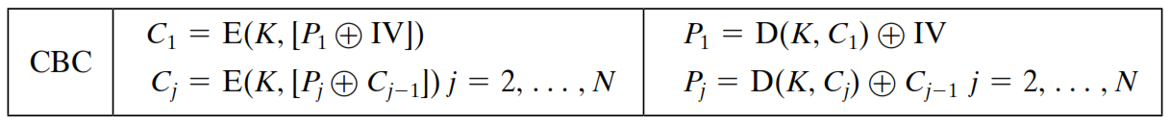
2. CBC - Encryption & Decryption
P₁
P₂
P_{N}
IV
C_{N-1}
K
K
…
K
Encrypt
Encrypt
Encrypt
C₁
C₂
C_{N}
C₁
C₂
C_{N}
K
K
…
K
Decrypt
Decrypt
Decrypt
IV
C_{N-1}
P₁
P₂
P_{N}

Slide 9
2. Cipher Block Chaining (CBC) – Cont…
Strength: because of the chaining mechanism of CBC, it is an appropriate mode for encrypting messages of length greater than b bits
Typical application:
General-purpose block oriented transmission
Authentication

Slide 10
3. Cipher Feedback Mode (CFB)
For AES, DES, or any block cipher, encryption is performed on a block of b bits. In DES, b = 64 and in AES, b = 128.
However, it is possible to convert a block cipher into a stream cipher, using cipher feedback (CFB) mode, output feedback (OFB) mode, and counter (CTR) mode.
A stream cipher eliminates the need to pad a message to be an integral number of blocks.

Slide 11
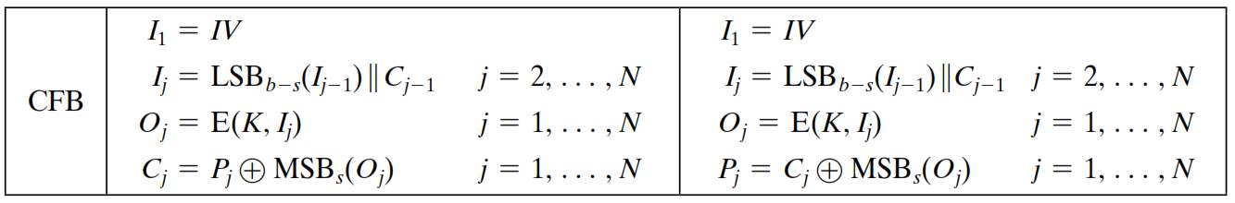
3. CFB Encryption
C_{N-1}
IV
Shift register b-s bits | s bits
Shift register b-s bits | s bits
K
K
K
Encrypt
Encrypt
Encrypt
…
Select s bits
Discard b-s bits
Select s bits
Discard b-s bits
Select s bits
Discard b-s bits
S bits
S bits
S bits
P₁
P₂
P_{N}
C₁
C₂
C_{N}
S bits
S bits
S bits
Notes:
Unit od transmission is 8 bits
Common value of s=8

Slide 12
3. CFB Decryption
C_{N-1}
IV
Shift register b-s bits | s bits
Shift register b-s bits | s bits
K
K
K
Encrypt
Encrypt
Encrypt
…
Select s bits
Discard b-s bits
Select s bits
Discard b-s bits
Select s bits
Discard b-s bits
C₁
C₂
C_{N}
S bits
S bits
S bits
P₁
P₂
P_{N}
S bits
S bits
S bits
Notes:
Unit od transmission is 8 bits
Common value of s=8

Slide 13
CFB Mode
The input to the encryption function is a b-bit shift register that is initially set to some initialization vector (IV).
The leftmost (most significant) s bits of the output of the encryption function are XORed with the first segment of plaintext P1 to produce the first unit of ciphertext C1 , which is then transmitted.
In addition, the contents of the shift register are shifted left by s bits, and C1 is placed in the rightmost (least significant) s bits of the shift register.
For decryption, the same scheme is used, except that the received ciphertext unit is XORed with the output of the encryption function to produce the plaintext unit.

Slide 14
4. Output Feedback Mode (OFB)
The output feedback (OFB) mode is similar in structure to that of CFB.
For OFB, the output of the encryption function is fed back to become the input for encrypting the next block of plaintext.
In CFB, the output of the XOR unit is fed back to become input for encrypting the next block.
The other difference is that the OFB mode operates on full blocks of plaintext and ciphertext, whereas CFB operates on an s-bit subset.
Nonce: A time-varying value that has at most a negligible chance of repeating, for example, a random value that is freshly generated for each use, a timestamp, a sequence number, or some combination of these.

Slide 15
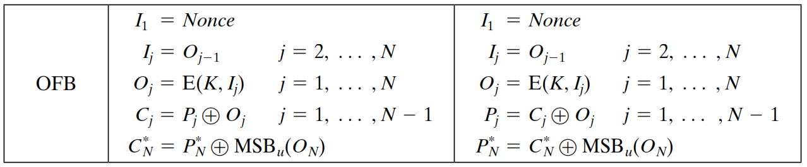
4. OFB Encryption
Nonce
K
K
…
K
Encrypt
Encrypt
Encrypt
P₁
P₂
P_{N}
C₁
C₂
C_{N}
Notes:
MSB upper bits (eg block of 64 and total 136 bits .... 8 bits )

Slide 16
4. OFB Decryption
Nonce
K
K
…
K
Encrypt
Encrypt
Encrypt
C₁
C₂
C_{N}
P₁
P₂
P_{N}

Slide 17
OFB Mode
Each bit in the ciphertext is independent of the previous bit or bits. i.e. Feedback is independent of transmission
This avoids error propagation which
It allows many error correcting codes to function normally even when applied before encryption
It helps recover from ciphertext bit errors, but cannot self-synchronize
Pre-compute of forward cipher is possible
Flipping a bit in the ciphertext produces a flipped bit in the plaintext at the same location

Slide 18
5. Counter Mode (CTR)
Counter (CTR) mode has increased recently with applications to ATM (asynchronous transfer mode) network security and IP sec (IP security).
A counter equal to the plaintext block size is used.
The counter value must be different for each plaintext block that is encrypted.
Typically, the counter is initialized to some value and then incremented by 1 for each subsequent block

Slide 19
5. CTR Encryption
Counter 1
Counter 2
Counter N
K
K
…
K
Encrypt
Encrypt
Encrypt
P₁
P₂
P_{N}
C₁
C₂
C_{N}

Slide 20
4. CTR Decryption
Counter 1
Counter 2
Counter N
K
K
…
K
Encrypt
Encrypt
Encrypt
C₁
C₂
C_{N}
P₁
P₂
P_{N}

Slide 21
Advantages of the CTR Mode
Strengths:
Needs only the encryption algorithm
Random access to encrypted data blocks
blocks can be processed (encrypted or decrypted) in parallel
Simple; fast encryption/decryption
Counter
Must be unknown and unpredictable
pseudo-randomness in the key stream is a goal

Slide 22
Summary of All Modes
Operation Mode | Description | Type of Result
ECB | Each n-bit block is encrypted independently with same key | Block Cipher
CBC | Same as ECB, but each block is XORed with previous cipher text | Block Cipher
CFB | Each s-bit block is XORed with s-bit key which is part of previous cipher text | Stream Cipher
OFB | Same as CFB, except that the input to the encryption algorithm is the output of preceding encryption algorithm | Stream Cipher
CTR | Same as OFB, but a counter is used instead of nonce | Stream Cipher

Slide 23
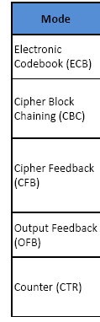
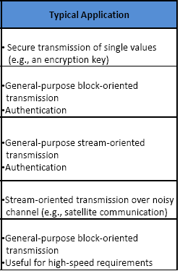
Typical Applications of All Modes
General-purpose transmission

Slide 24
Use of Stream Ciphers
Although the five modes of operations enable the use of block ciphers for encipherment of messages or files in large units (ECB, CBC, and CTR) and small units (CFB and OFB), sometimes pure streams are needed for enciphering small units of data such as characters or bits.
Stream ciphers are more efficient for real-time processing.
Several stream ciphers have been used in different protocols during the last few decades.
Examples: RC4, A5/1

Slide 25
RC4
RC4 means Rivest Cipher 4 invented by Ron Rivest in 1987 for RSA Security. It is a Stream Ciphers.
Stream Ciphers operate on a stream of data byte by byte.
RC4 stream cipher is one of the most widely used stream ciphers because of its simplicity and speed of operation.
It is a variable key-size stream cipher with byte-oriented operations. It uses either 64 bit or 128-bit key sizes.
It is generally used in applications such as Secure Socket Layer (SSL), Transport Layer Security (TLS), and also used in IEEE 802.11 wireless LAN std.

Slide 26
A5/1
A5/1 is a stream cipher used to provide over-the-air communication privacy in the GSM cellular telephone standard.
It is one of several implementations of the A5 security protocol.

Slide 27
Synchronous & Asynchronous Stream Ciphers
With synchronous stream ciphers, the bits of the key stream do not depend on the ciphertext bits.
With asynchronous stream ciphers the key stream can be inferred (provided one knows the secret key) from previous bits of the cipher stream.
CTR would be an example of a synchronous streaming mode and CFB would be an example of an asynchronous mode.

Slide 28
Synchronous & Asynchronous stream ciphers (Cont.)
Synchronous ciphers have these advantages and disadvantages:
Key stream can be pre-computed before plaintext or ciphertext is provided, often with parallelism. typically faster and more efficient than block ciphers when encrypting large volumes of data in real-time
As the keystream is deterministic, they have the disadvantage of ciphertext malleability (a known change in ciphertext produces a known change in plaintext) and so will need to be combined with some form of message authentication.
Asynchronous ciphers have these advantages and disadvantages:
The key stream can only be computed once the plaintext/ciphertext is provided. However, changing the ciphertext changes subsequent key stream and so there is considerably less malleability.
They also allow easy synchronization at any point in transmission.
They are more computationally intensive and slower than synchronous stream ciphers because of the additional complexity in generating the keystream

Slide 29
Multiple Encryption
Given the potential vulnerability of DES to a brute-force attack, there has been considerable interest in finding an alternative.
One approach is to design a completely new algorithm, of which AES is a prime example.
Another alternative, which would preserve the existing investment in software and equipment, is to use multiple encryption with DES and multiple keys.

Slide 30
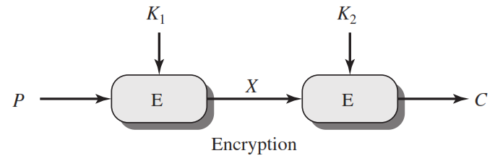
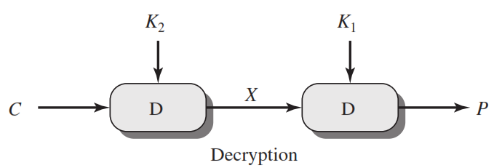
Double DES
C=E(K₂,E(K₁, P))
X = E(K₁, P) = D(K₂, C)
P=D(K₁,D(K₂, C))

Slide 31
Meet in the Middle Attack
Meet-in-the-middle (MITM) attacks are often executed to decode multiple data encryption standard (DES) techniques.
This attack involves encryption from one end, decryption from the other and matching the results in the middle.
An attacker can use a MITM attack to bruteforce Double DES
an attacker encrypts the plaintext with all possible keys for the first encryption (2^56 operations) and then decrypts the ciphertext with each possible key for the second encryption (2^56 operations)

Slide 32
Meet in the Middle Attack Step-1
Suppose cryptanalyst knows P and corresponding C.
Now, the aim is to obtain the values of K₁ and K₂.
For all possible values (2⁵⁶) of key K1, the cryptanalyst would encrypt the P by performing E(K1,P).
The cryptanalyst would store output in a table.
Possible Keys
(Key = K1)
00
01
10
11
P
Table of Cipher Text
Encrypt
Cryptanalyst encryption operation

Slide 33
Meet in the Middle Attack Step-2
Cryptanalyst decrypts the known C with all possible values of K2.
In each case cryptanalyst will compare the resulting value with the all values in the table of ciphertext.
Possible Keys
(Key = K2)
00
01
10
11
Table of Cipher Text
C
Decrypt
For each result do a table look up
Cryptanalyst decryption operation
Thus, K1 and K2 can be obtained

Slide 34
Triple DES
An obvious counter to the meet in the middle attack is to use 3 stages of encryption with 3 different keys
However, if 3 different keys are used, it has limitations of requiring a key length of 56x3= 168 bits which may be somewhat unwisely.
As an alternative, Tuchman proposed a triple encryption method that uses only 2 keys.

Slide 35
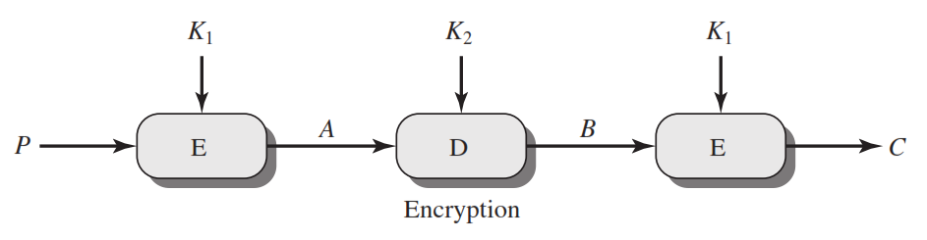
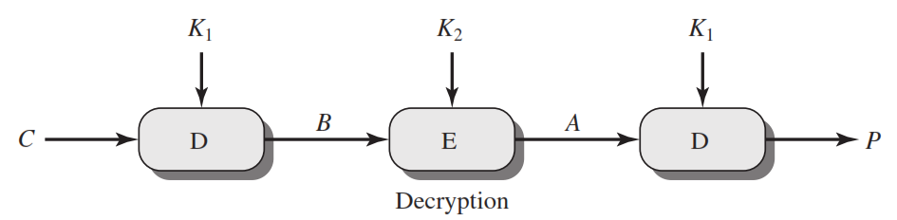
Triple DES
C=E(K₁,D(K₂, E(K₁,P)))
P=D(K₁,E(K₂, D(K₁,C)))

